Slide 1
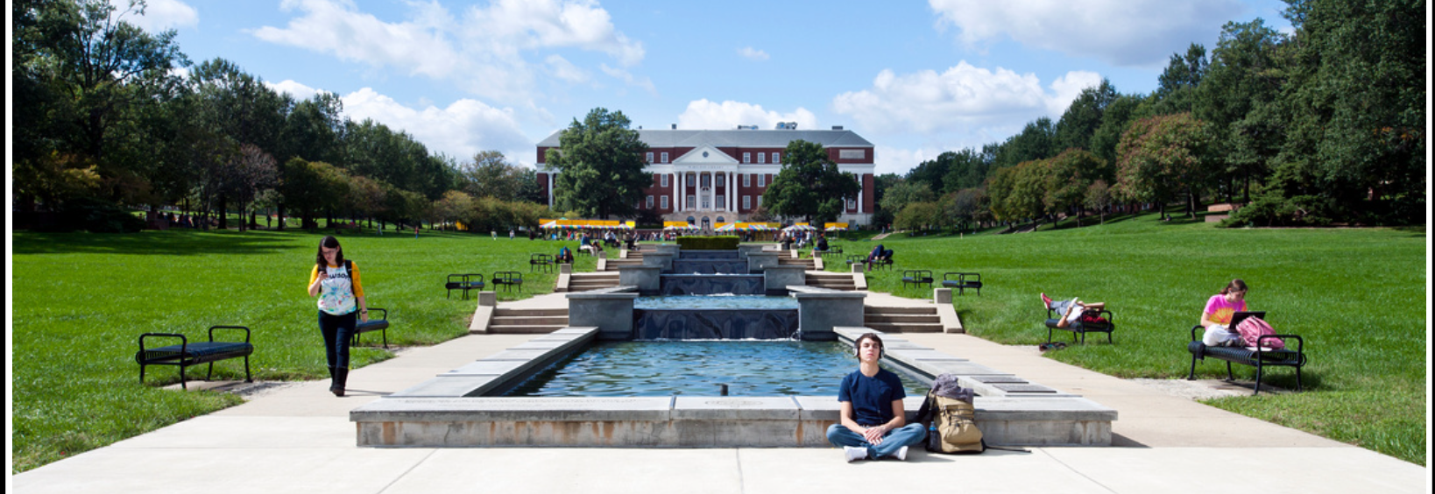
TerpRank Ranks
Group - BUDT 0506-01
Date : December 8th 2021
‹#›
Adarsh Challa, Gauri Goel, Prince Nwankwoala, Xingye Wang, Zezhong Zhang

Slide 2


Agenda
Introduction
Conceptual Database Design
Use Cases
Inferences
1
3
5
7
8
Suggestions
2
4
6
Background
Physical Design
Applications

Slide 3

Mission Statement
Identify the best pair of student and B-School, the one they desire and deserve.
Provide B-schools insights into specific areas they must revamp to lift their rankings.

Slide 4



Mission Objectives
To study the impact of tuition fees on school rankings
To compare admitted students’ GMAT, GRE scores, and GPAs with respect to schools’ Employer Reputation
Compare the universities on the basis of actual rankings and students’ ratings
Identify the difference in the number of applicants when the application fee is greater or lesser than $200

Slide 5




Background
Users
Students (US & Abroad)
USA B-Schools
Data Sources

Slide 6
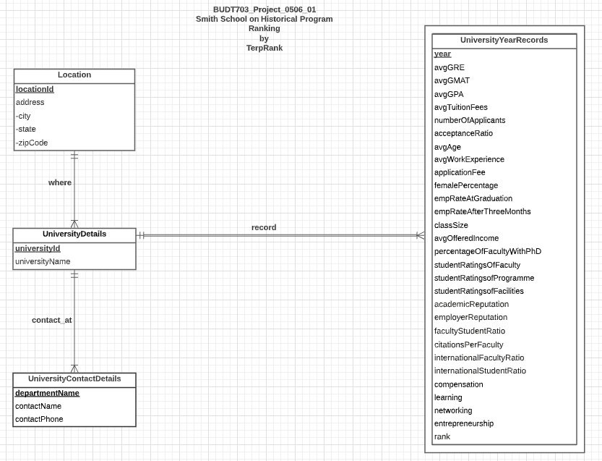
Conceptual Database Design
Notes:
Thanks Adarsh! After figuring out database purpose. Our database will be mainly for two clients(schools’ policy maker and students who want to apply schools). For universities, we designed Years’ ranking records entity to contain all the valuable attributes that could affect school’s ranking. So, schools policy makers could use it to positive policy changes, make strategic and academic changes, attract prospective students and partnerships.
For students who want to apply universities, we design university’s location, name and admission/financial contact to use.

Slide 7
Relational Schema
Location ( locationId, city, state, zipCode)
UniversityDetails ( locationId, universityId, universityName)
UniversityYearRecords ( universityId , year, avgGRE, avgGMAT, aveGPA , avgTuitionFees, noOfApplicants, acceptanceRatio, avgAge, avgWorkExperience, applicationFee, femalePercentage, empRateAtGraduation, empRateAfterThreeMonths, classSize, avgOfferedIncome, percentageOfFacultyWithPhD, studentRatingsOfFaculty, studentRatingsofProgramme, studentRatingsofFacilities, academicReputation, employerReputation, facultyStudentRatio, citationsPerFaculty, internationalFacultyRatio, internationalStudentRatio, compensation, learning, networking, entrepreneurship, rank)
UniversityContactDetails ( universityId, departmentName, contactName, contactPhone)
Notes:
And then, as you can see, we use two foreign keys:UniversityId and locationID to connect these entities together and build the relationship of whole database.

Slide 8
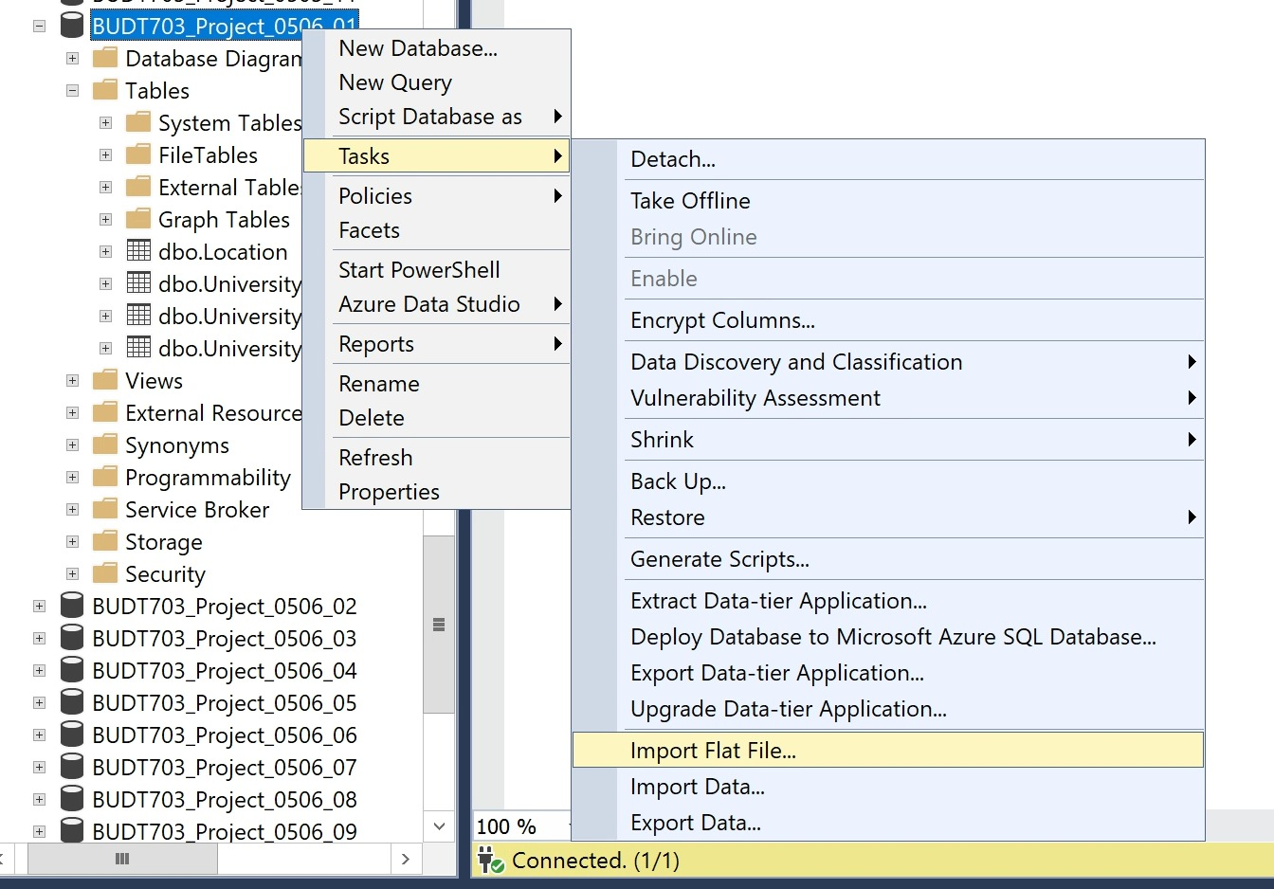
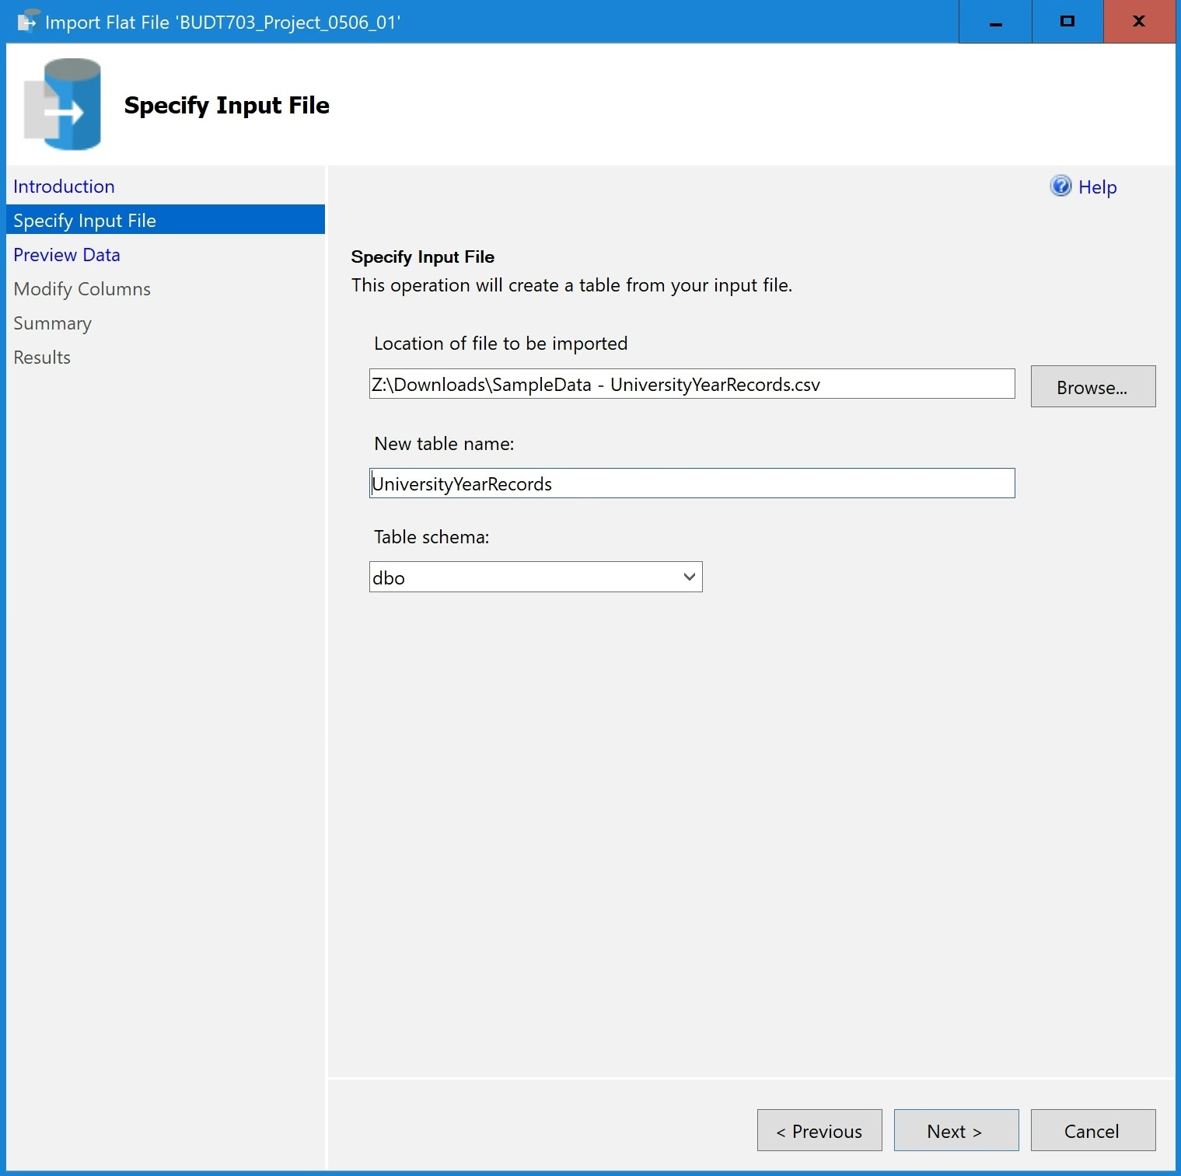
Physical Database Design

Slide 9
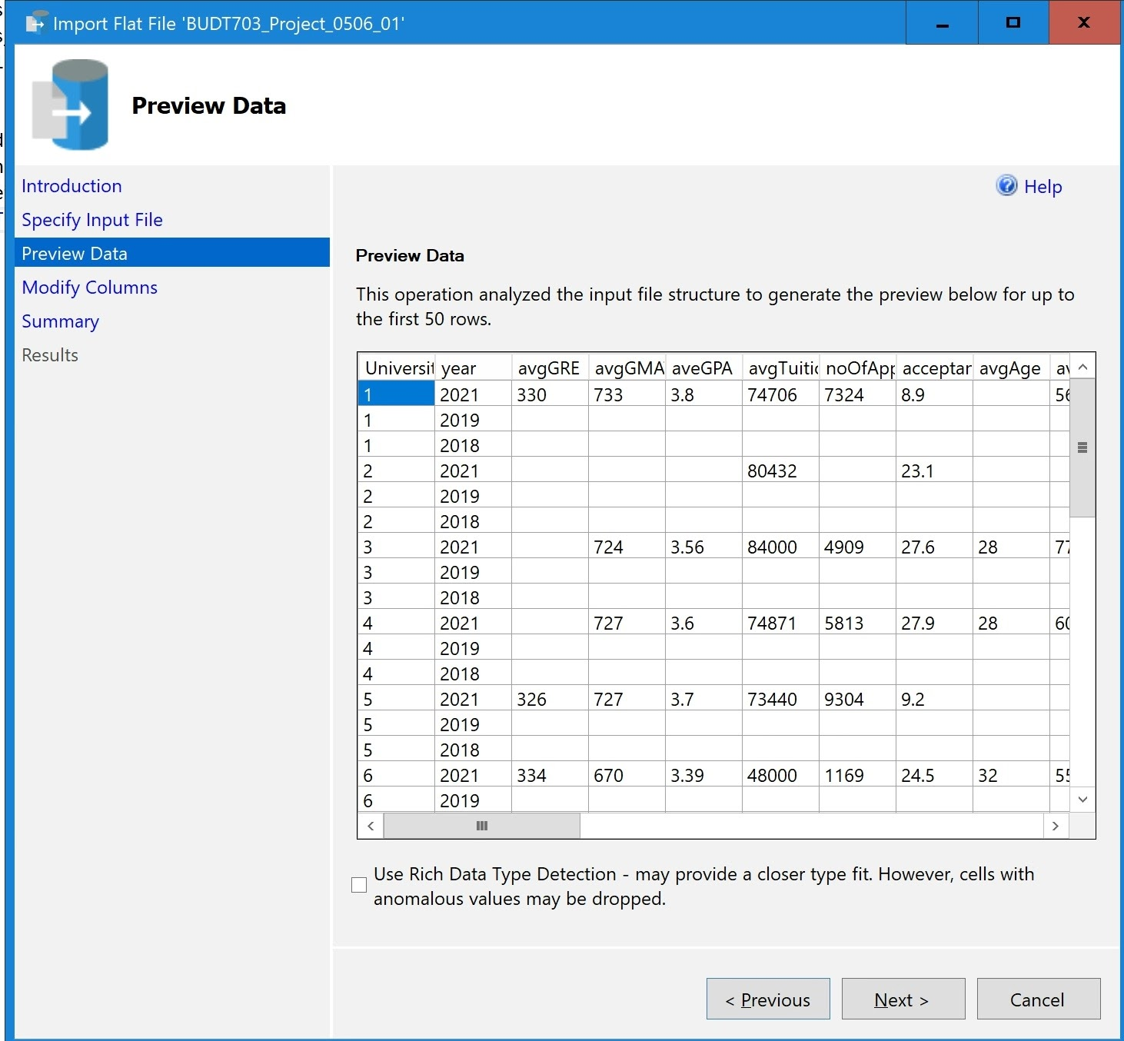
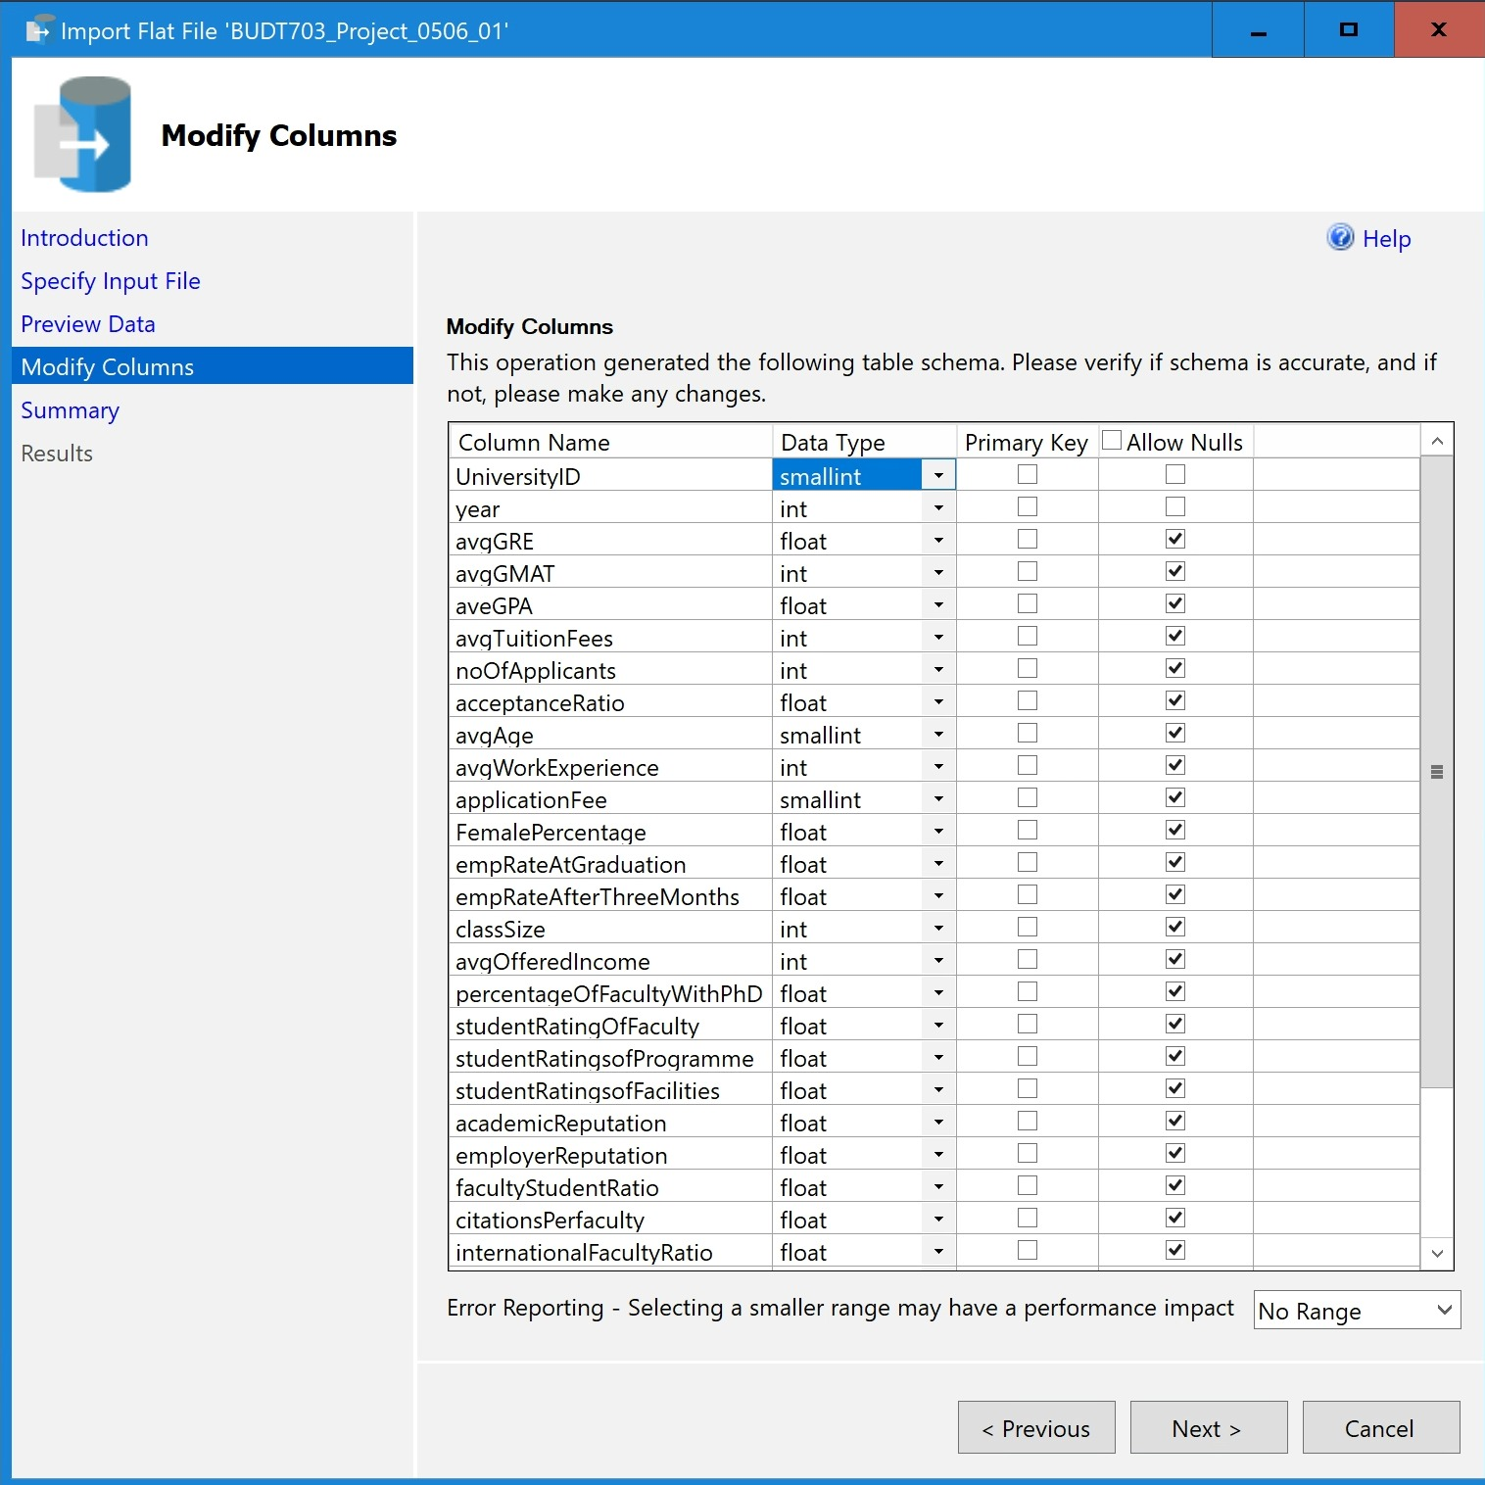
Physical Database Design
Notes:
Slide 8 , data types

Slide 10

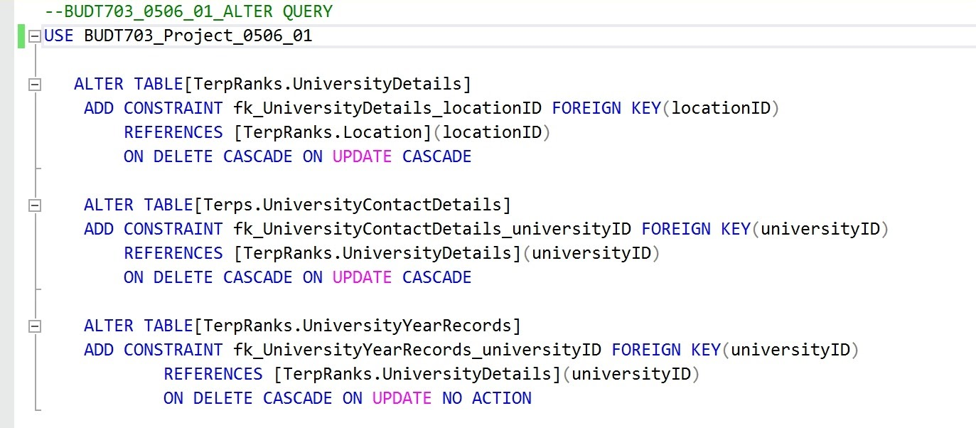
Physical Database Design

Slide 11
Use Case 1
Compare admitted students’ average GMAT, GRE scores and GPAs with respect to schools’ employer reputation and rankings
CREATE VIEW [EmployerReputationAnalysis] AS
SELECT d.universityName,y.avgGRE,y.avgGMAT,y.avgGPA, y.employerReputation , y.rank
FROM [TerpRanks_UniversityYearRecords] y, [TerpRanks_UniversityDetails] d
WHERE y.universityId = d.universityId AND y.employerReputation IS NOT NULL
AND y.avgGRE IS NOT NULL
AND y.avgGMAT IS NOT NULL
AND y.avgGPA IS NOT NULL
AND y.avgGPA IS NOT NULL
AND y.Rank IS NOT NULL;
Notes:
For Use Case 1 , we want to Compare admitted students’ GMAT, GRE scores and GPAs with respect to schools’ employer reputation and rankings. and this use case is aimed to help the smith school to improve programs, Here is the code that we created the view table to do the analysis

Slide 12
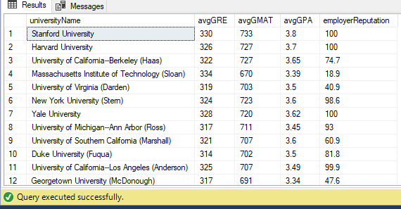
Application 1
Find the Average GRE, GMAT, GPA, Employer Reputation scores for the top 20 B-schools
SELECT TOP 20 universityName,avgGRE,avgGMAT,avgGPA, employerReputation
FROM [EmployerReputationAnalysis]
ORDER BY rank
Notes:
Here is the application of our analysis, we choose the top 20 business schools to find their average GRE, GMAT and GPA and employer reputation, and this is our result.

Slide 13
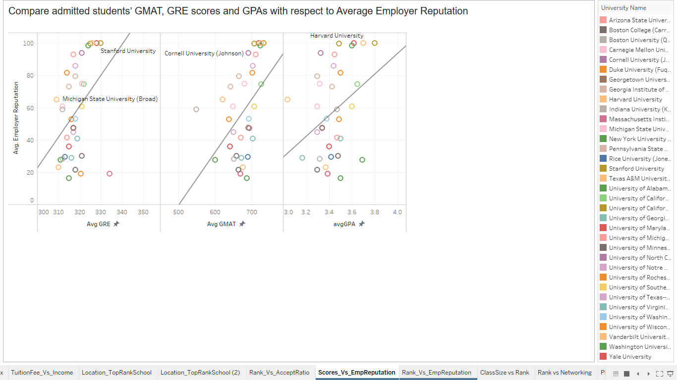
Visualization 1
Notes:
From the graphs, we can see that universities with higher standardized tests scores and gpas tends to have higher employer reputation, in all three graphs we can see a positive trend.

Slide 14
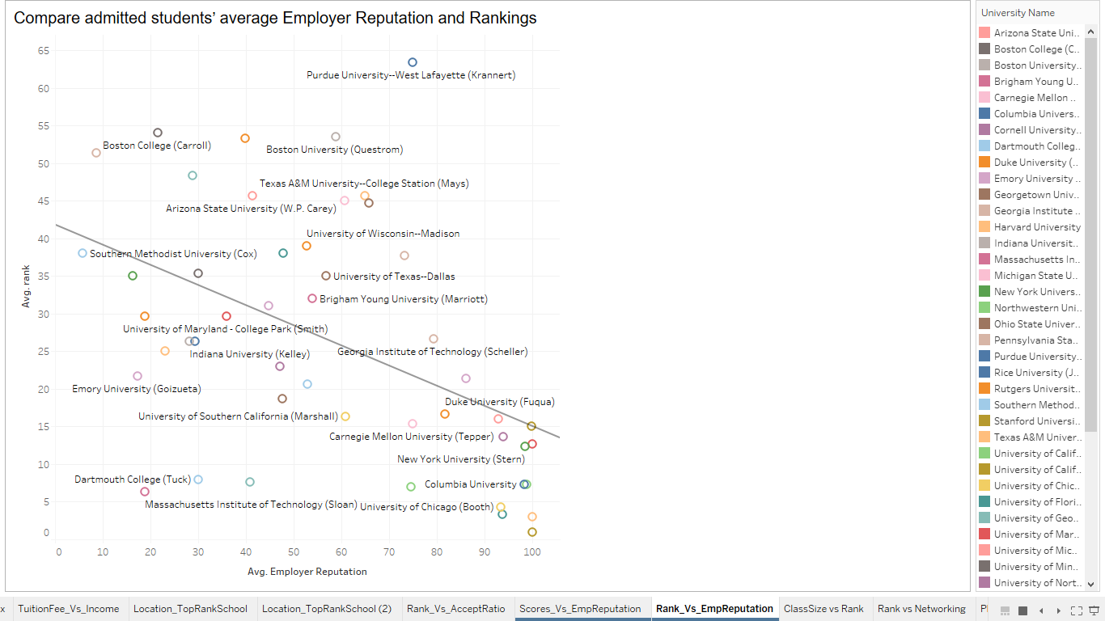
Visualization
Notes:
Here is the graph of employer reputation with rank. On the left top corner, we can see that higher ranked universities tend to have better employer reputation.

Slide 15
Use Case 2
Compare admitted students’ GMAT, GRE scores and GPAs with respect to school rankings
CREATE VIEW [AverageScoresBschools] AS
SELECT d.universityName,AVG(y.avgGRE) AS ‘Average_GRE’,AVG(y.avgGMAT) AS ‘Average_GMAT’,AVG(y.avgGPA) AS ‘Average_GPA’, AVG(y.rank) AS ‘Rank’
FROM [TerpRanks.UniversityYearRecords] y, [TerpRanks.UniversityDetails] d
WHERE y.universityId = d.universityId
HAVING AVG(y.avgGRE) IS NOT NULL
AND AVG(y.avgGMAT) IS NOT NULL
AND AVG(y.avgGPA) IS NOT NULL
AND AVG(y.Rank) IS NOT NULL;

Slide 16
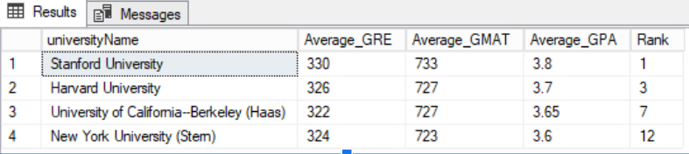
Application 2
Find the top 10 universities where the Average GMAT score is greater than 720
SELECT TOP 10 *
FROM [AverageScoresBschools]
WHERE Average_GMAT > 720
ORDER BY Rank

Slide 17
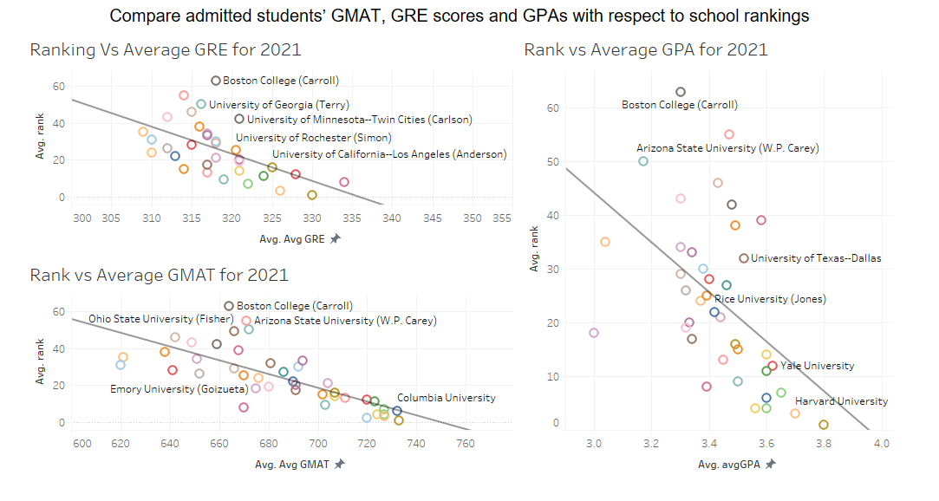
Visualization 2

Slide 18
Inferences
Class Size is negatively correlated with the Rankings , as the class size reduces, the rank of the B-School improves.
The higher #networking events a B-School conducts , the higher the rank the school has.
Percentage of Faculty with PhD plays a pivotal role in the ranking of a B- School.
The more the geographical diversity a classroom has, the higher the rank the school has.
Students ratings of program content is very much in line with the school rankings
The availability of Facilities in a B-School is not a significant factor or not correlated with the rank of B- Schools
Employer Reputation Influences Ranking Significantly along with Average GRE, Average GMAT and Average GPA scores.
Higher the average Tuition fees of a B-school, higher the average Offered income to the students.
Universities having students with a larger average work experience have better rankings.
States- MA, Illinois, California have 2 top-10 universities each.
The top 10 schools have an application fee greater than $200 and yet see a 3 times higher number of applicants.

Slide 19
Suggestions to the Robert H.Smith School
Reduce the class size
Conduct more networking events
Employ more faculties who hold a PhD degree
Increase the geographical diversity score in the classroom
Improve their program curriculum
Increase the admission scores’ requirements
UMD should consider lowering down their tuition fee
Should give admits to students who have more number of months’ of work experience
Notes:
https://drive.google.com/file/d/1klQV4Lq8seNzNR-7Ju7Dup37zQn7wbt5/view?usp=sharing

Slide 20
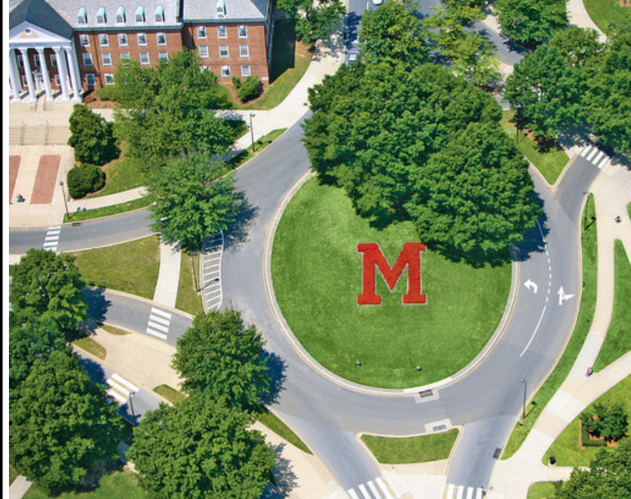
ThankYou
Questions!!

